Slide 1

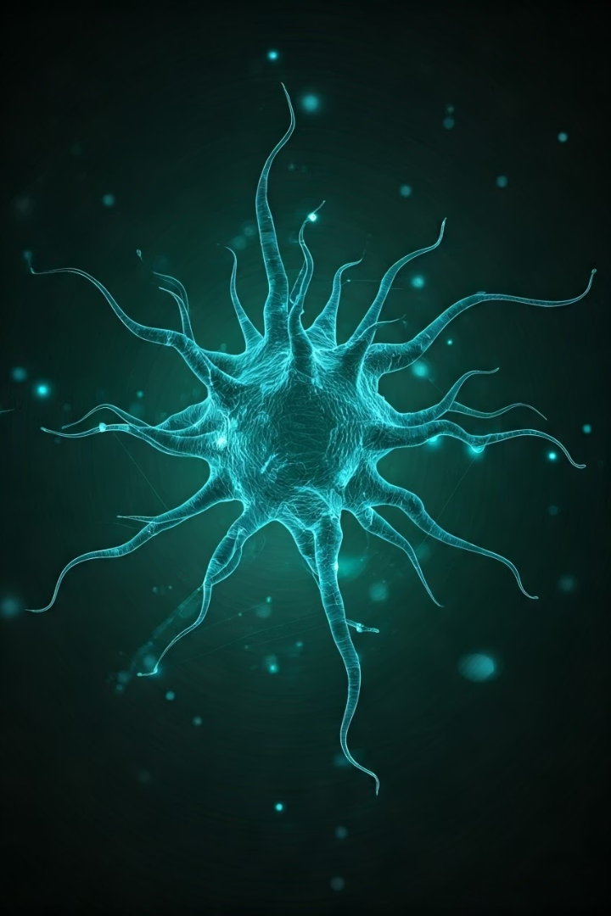
INFO617 Project
Team 5
A comprehensive analysis of classification approaches for physician-patient dialogues using traditional machine learning and advanced deep learning techniques.
Team Members:
Adhyayan Amit Jain
Gauri V Nair
Jesin K Joy
Rakshitha V S

Slide 2
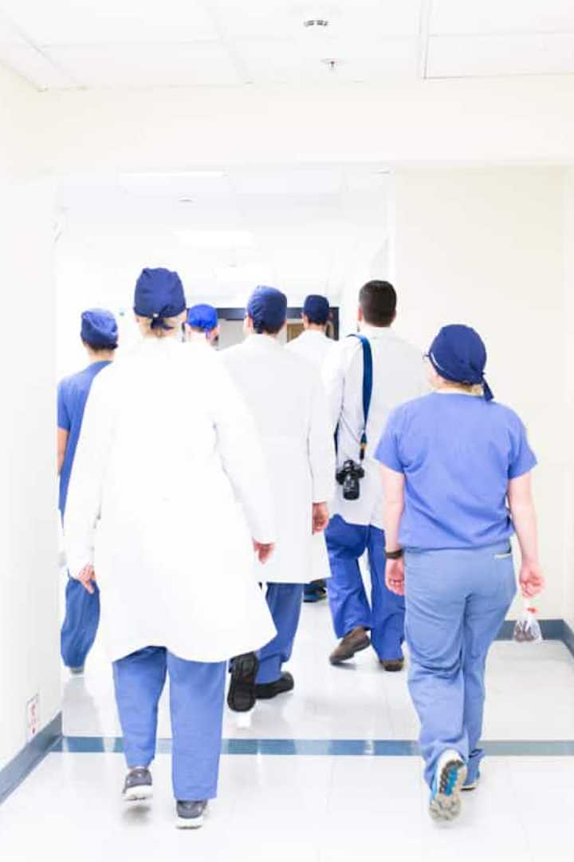
Project Overview
Problem Statement
Dataset
Classify individual sentences into 15 healthcare-related categories based on Social Support Theory.
4030 training samples with 1187 test samples provide the foundation for our models.
Approach
Compare traditional vs. deep learning models to optimize classification performance while addressing real-world clinical communication challenges.

Slide 3
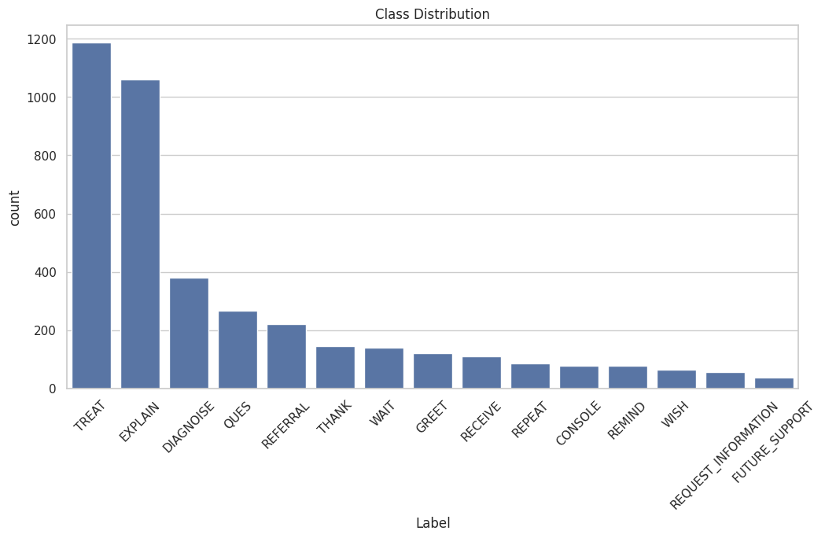
Label Class Distribution

Slide 4
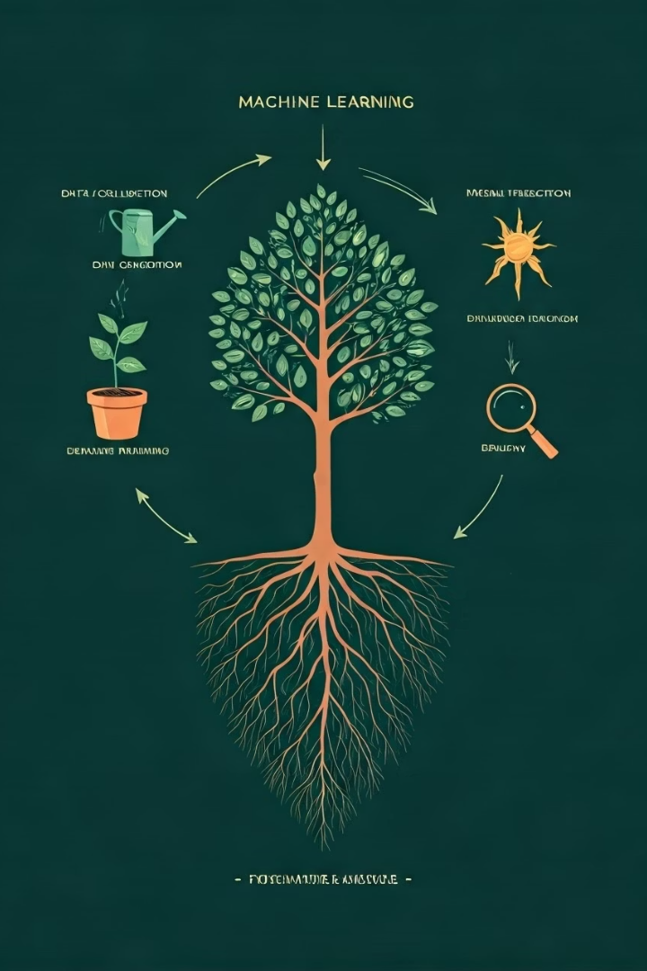
Our Iterative Approach
Establish Baseline
Implement traditional machine learning with Logistic Regression and SVM.
Address Imbalance
Apply SMOTE and oversampling techniques to equalize class representation.
Implement Deep Models
Develop CNN and ClinicalBERT architectures to explore feature-rich architectures.
Fine-tune Transformers
Optimize DistilBERT for optimal performance-efficiency balance.
Each step increased model complexity while measuring performance gains.

Slide 5




Challenges and Learnings
Class Imbalance Issues
Tokenization Complexity
Rare categories like FUTURE_SUPPORT suffered from misclassification due to limited examples.
Deep learning models required precise handling of text segmentation.
Semantic Limitations
TF-IDF approaches performed adequately but missed contextual relationships.

Slide 6
Features Extracted
Traditional Models
Deep Learning Models
Class Imbalance Solutions
TF-IDF features extracted from conversation text.
Contextual embeddings using specialized tokenizers.
Implemented sampling techniques to address uneven class distribution.
1-gram word features
DistilBERT tokenization
RandomOverSampler
2-gram phrase features
ClinicalBERT tokenization
SMOTE
Notes:
To classify the medical conversation texts, we used different modeling approaches, each with distinct feature extraction and usage strategies:
Traditional Machine Learning Models (Logistic Regression, SVM, KNN)
We extracted TF-IDF vectors capturing the frequency of words and two-word phrases. These vectors were fed directly into classifiers — Logistic Regression, SVM, and KNN — to separate classes based on word importance. While effective for basic patterns, these models could not understand sentence meaning or word relationships.
Tree-Based Models (Decision Tree, Random Forest, Extra Trees)
Tree-based models also used TF-IDF features. Decision Trees split based on important words, while Random Forest and Extra Trees combined multiple trees for better stability. They handled feature interactions better than traditional models, but still missed deeper semantic context.
Convolutional Neural Network (CNN)
For CNN, we created dense word embeddings using Keras Tokenizer. These embeddings captured word meanings and passed through convolutional layers to detect local text patterns. CNN improved over traditional models but struggled to fully understand sentence-level meaning.
Transformer Models (ClinicalBERT, DistilBERT)
With ClinicalBERT and DistilBERT, we used contextual token embeddings. Each word's meaning adapted based on its surrounding context. The embeddings were processed through transformer layers, and the models were fine-tuned for our classification task. This approach required minimal preprocessing and delivered the best performance by deeply understanding language structure.

Slide 7






Tree-Based
Models Attempted
Decision Tree
Random Forest
Extra Trees
XGBoost
Traditional ML
Logistic Regression
SVM
KNN
Naive Bayes
Ridge Classifier
Deep Learning
CNN
ClinicalBERT
➔ Strategy: Progress from shallow, simple models to sophisticated, context-aware architectures.
DistilBERT
Notes:
to answer the question
Which algorithm(s) did our model use?
We explored and implemented a wide range of algorithms to progressively improve performance:
Traditional Machine Learning
Logistic Regression, Support Vector Machine (SVM), K-Nearest Neighbors (KNN)
Tree-Based Models
Decision Tree, Random Forest, Extra Trees
Deep Learning Models
Convolutional Neural Network (CNN), ClinicalBERT, DistilBERT
Progression Strategy:
Started with simple traditional models for baseline → moved to tree-based ensemble methods → finally transitioned to deep learning and transformer-based architectures.

Slide 8

Logistic Regression Model
0.65
Validation F1
Balanced measure of precision and recall
65%
Accuracy
Overall correct classifications
Served as a strong baseline model. TF-IDF with logistic regression showed limitations in capturing complex language patterns.

Slide 9
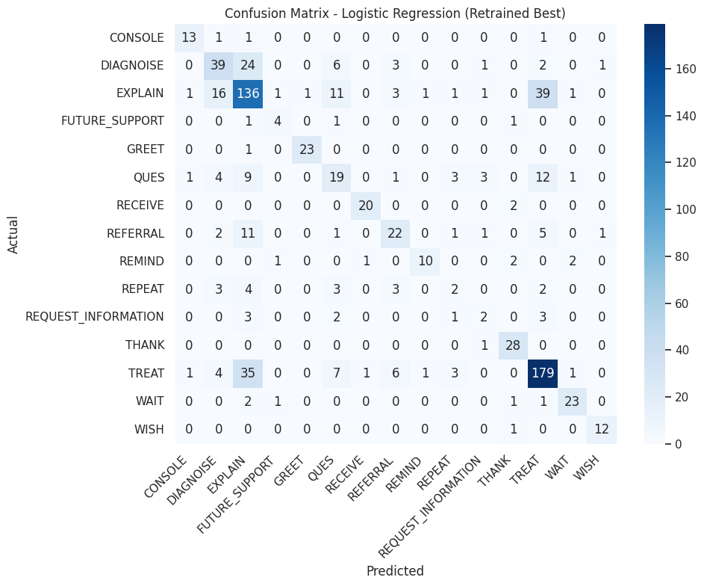
Model Performance Overview:
This confusion matrix summarizes the prediction results of the Logistic Regression (Retrained Best) model on the validation set. Most classes show strong correct classification along the diagonal, especially for high-frequency categories like TREAT, EXPLAIN, and THANK.
Misclassifications are observed between similar conversational intents, such as EXPLAIN, TREAT, and DIAGNOSE, which may share overlapping language features.
Overall, the model demonstrates good generalization across classes, with some challenges in less frequent categories like REPEAT and REQUEST_INFORMATION.

Slide 10






Support Vector Machine
Performance
F1: ~0.61, Accuracy: ~65%
Implementation
TF-IDF + Support Vector Classifier
Analysis
Higher margin classifier with decreased minority class performance

Slide 11
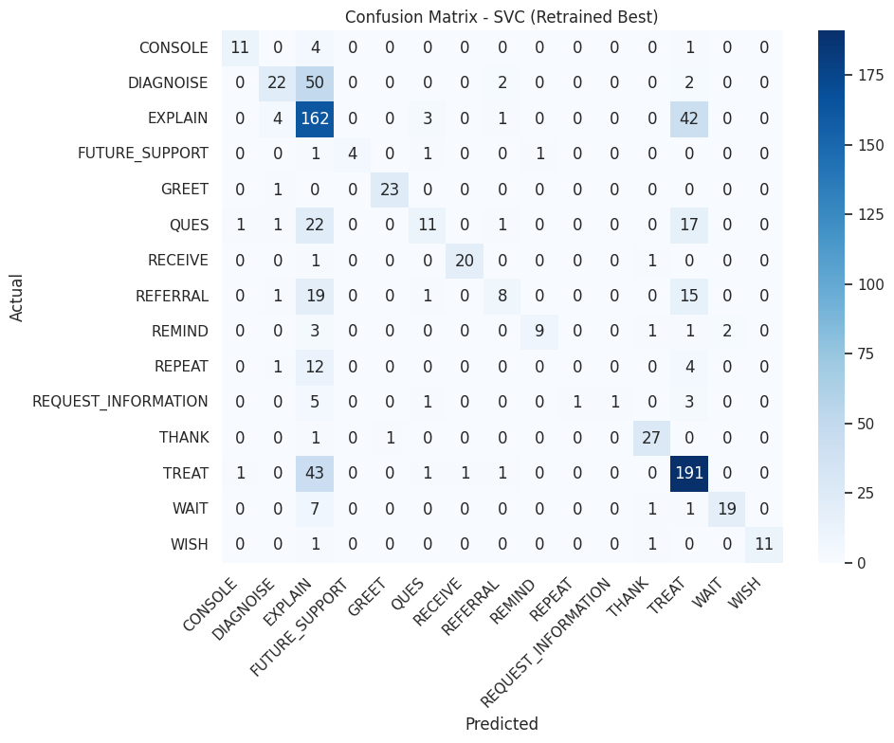
Model Performance Overview:
This confusion matrix presents the classification results of the Support Vector Classifier (Retrained Best) model on the validation set.
The model performed strongly in identifying major classes such as TREAT, EXPLAIN, and THANK, with clear clustering along the diagonal.
However, some misclassifications occurred, particularly between QUES, DIAGNOSE, and EXPLAIN, where semantic overlaps between questions and explanations likely influenced predictions.
Overall, SVC delivered good accuracy on dominant categories, while minority and overlapping classes exhibited slightly higher confusion.

Slide 12



K-Nearest Neighbors
Technique
TF-IDF + KNN classifier
Performance
F1: ~0.21, Accuracy: ~27%
Limitations
Poor performance with sparse TF-IDF data

Slide 13
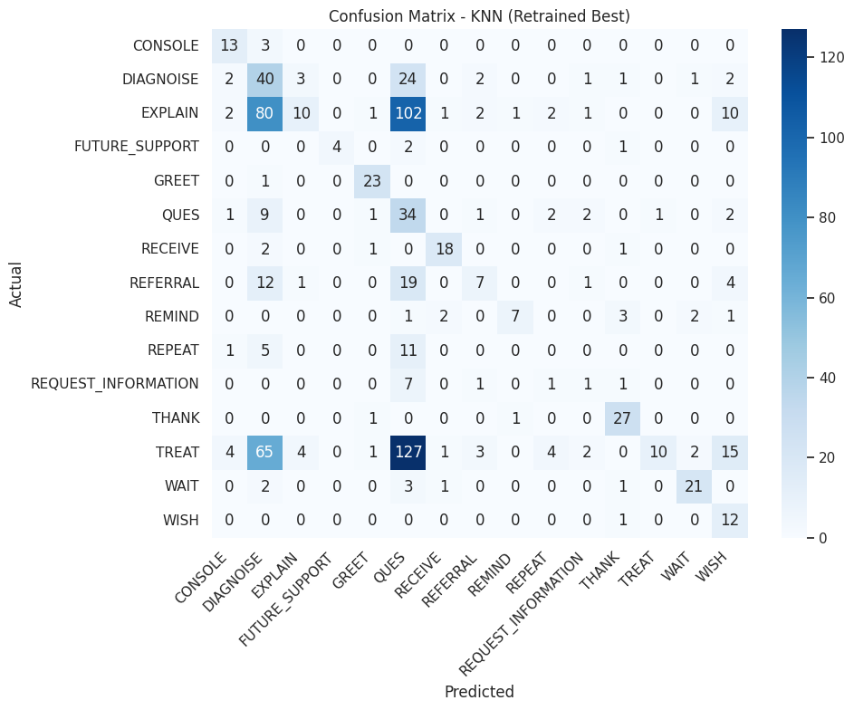
Model Performance Overview:
This confusion matrix shows the results for the K-Nearest Neighbors (Retrained Best) model.
While KNN managed reasonable predictions for major classes like TREAT and EXPLAIN, significant confusion is observed across several categories, especially between EXPLAIN, DIAGNOSE, and TREAT.
KNN struggled more with minority and semantically overlapping classes, reflecting its limitations in handling high-dimensional sparse TF-IDF representations without strong distance boundaries.
Overall, KNN shows acceptable but weaker performance compared to other classifiers in this project.

Slide 14
Naive Bayes Model
0.67
Validation F1
Balanced measure of precision and recall
67%
Accuracy
Overall correct classifications
Served as a strong baseline model. TF-IDF with logistic regression showed limitations in capturing complex language patterns.

Slide 15
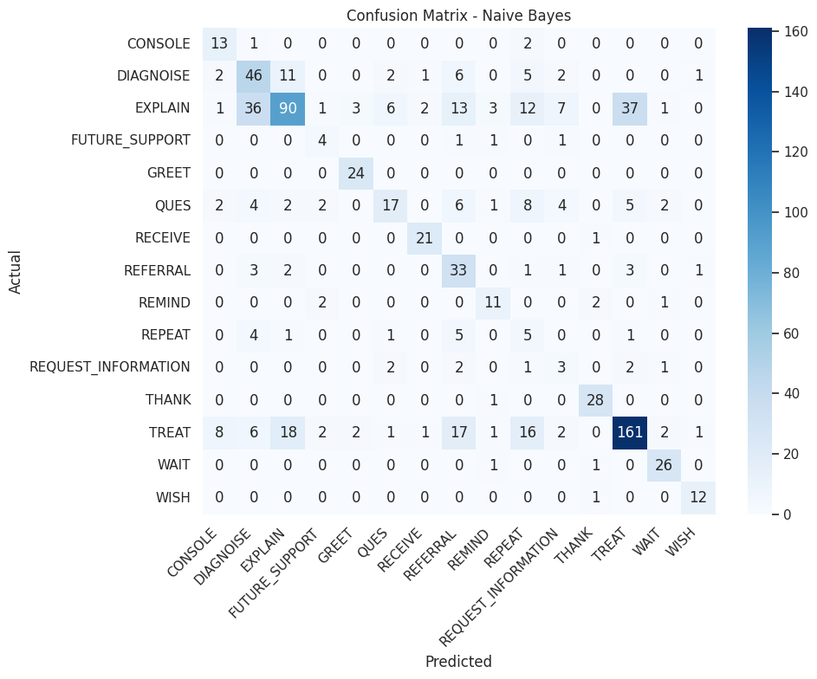
Model Performance Overview:
This confusion matrix presents the validation results for the Naive Bayes model.
Naive Bayes performed well on major classes such as TREAT, EXPLAIN, and THANK, but demonstrated higher confusion among related classes like DIAGNOSE and EXPLAIN.
Due to its simple probabilistic assumptions, Naive Bayes struggled more with semantically overlapping categories, particularly QUES, REQUEST_INFORMATION, and TREAT.
Overall, while efficient and fast, Naive Bayes showed lower precision compared to ensemble methods like Random Forest and Extra Trees.

Slide 16
Ridge Classifier Model
0.67
Validation F1
Balanced measure of precision and recall
67%
Accuracy
Overall correct classifications
Served as a strong baseline model. TF-IDF with logistic regression showed limitations in capturing complex language patterns.

Slide 17
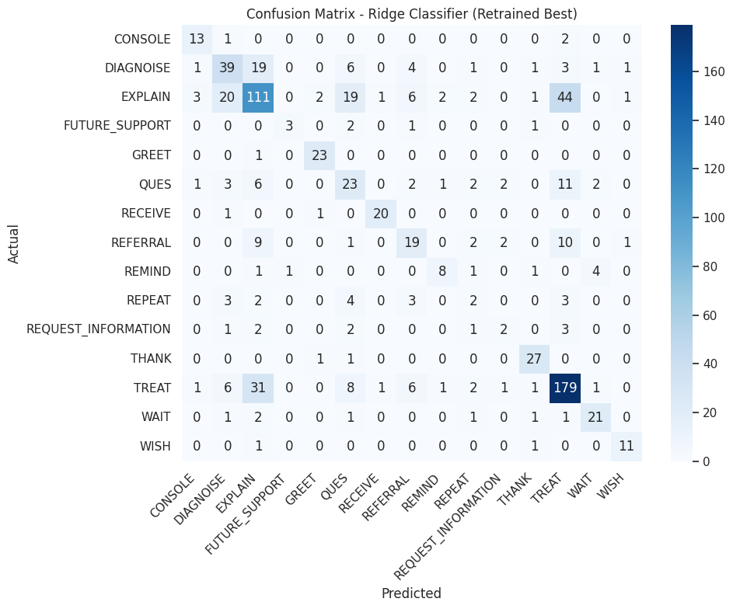
Model Performance Overview:
This confusion matrix represents the validation performance of the Ridge Classifier (Retrained Best) model.
The model delivered strong predictions for major classes like TREAT, EXPLAIN, and THANK, indicated by a dominant diagonal structure.
Moderate confusion was observed between related classes such as DIAGNOSE, EXPLAIN, and TREAT, particularly where semantic overlaps were common.
Overall, Ridge Classifier provided a good balance between precision and recall, offering competitive performance without overfitting, similar to Logistic Regression.

Slide 18
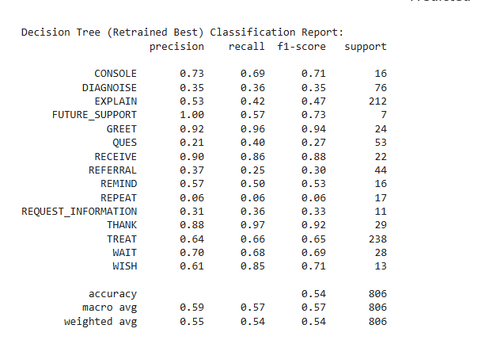
Decision Tree Classifier
0.55
Validation F1
Balanced measure of precision and recall
55%
Accuracy
Overall correct classifications
The Decision Tree provided a reasonable starting point with 55% accuracy, but its limited ability to distinguish overlapping medical categories highlights the need for more advanced models.

Slide 19
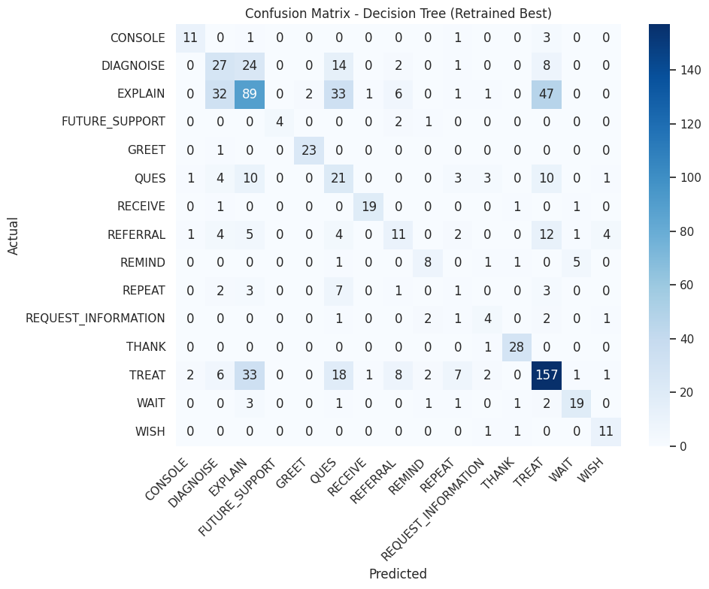
Model Performance Overview
This confusion matrix shows the validation performance of the Decision Tree (Retrained Best) model.
While the model captured dominant classes like TREAT, EXPLAIN, and THANK reasonably well, noticeable confusion occurred between EXPLAIN, DIAGNOSE, and TREAT, which share semantic similarities.
Decision Trees tended to overfit on frequent classes, causing weaker generalization on minority and overlapping categories such as QUES, REFERRAL, and REPEAT.
Overall, the model performed decently but showed a trade-off between specificity and overfitting.

Slide 20
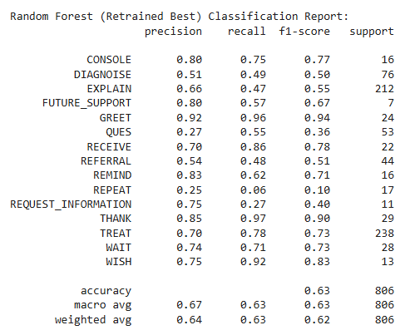
Random Forest
0.63
Validation F1
Balanced measure of precision and recall
63%
Accuracy
Overall correct classifications
The Random Forest model showed improved performance with 63% accuracy and a Validation F1-score of 0.63, offering better balance across classes, though further refinement is needed to fully address misclassifications in complex medical categories.

Slide 21
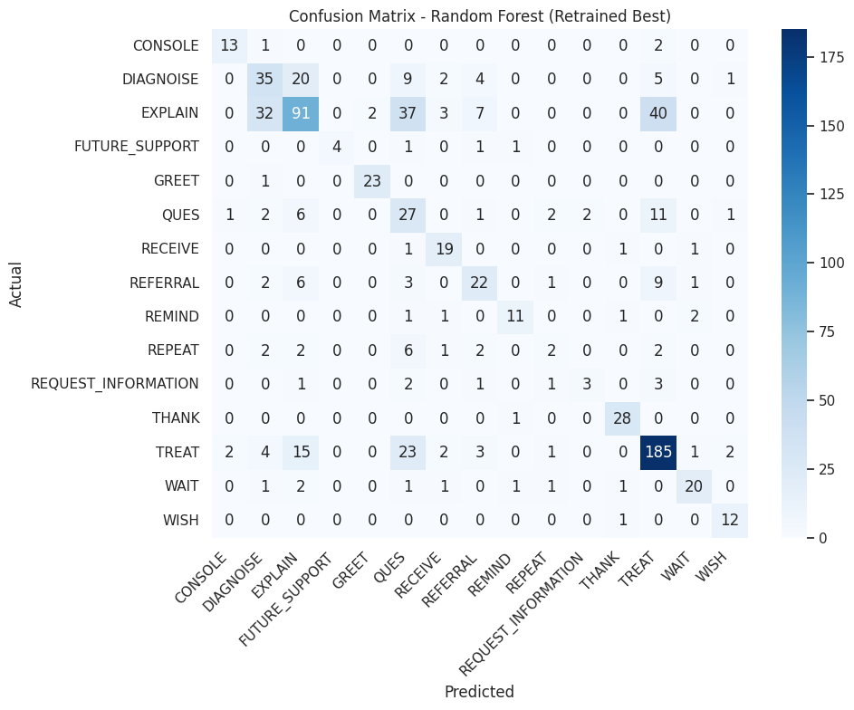
Model Performance Overview:
This confusion matrix displays the validation results for the Random Forest (Retrained Best) model.
The model achieved strong classification performance for major classes like TREAT, EXPLAIN, and THANK, reflected by a concentrated diagonal.
Some confusion persisted between overlapping classes such as EXPLAIN, DIAGNOSE, and TREAT, but Random Forest showed improved stability compared to a single Decision Tree.
Overall, Random Forest delivered better generalization, especially on frequent classes, while maintaining moderate performance across minority labels.

Slide 22
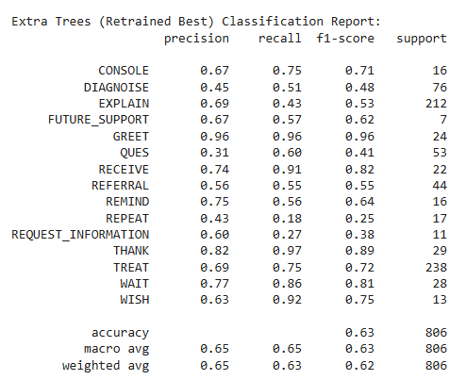
Extra Trees Classifier
0.63
Validation F1
Balanced measure of precision and recall
63%
Accuracy
Overall correct classifications
The Extra Trees model achieved 63% accuracy and a Validation F1-score of 0.63, offering consistent improvement across classes, although further enhancements are needed to better separate overlapping medical categories.

Slide 23
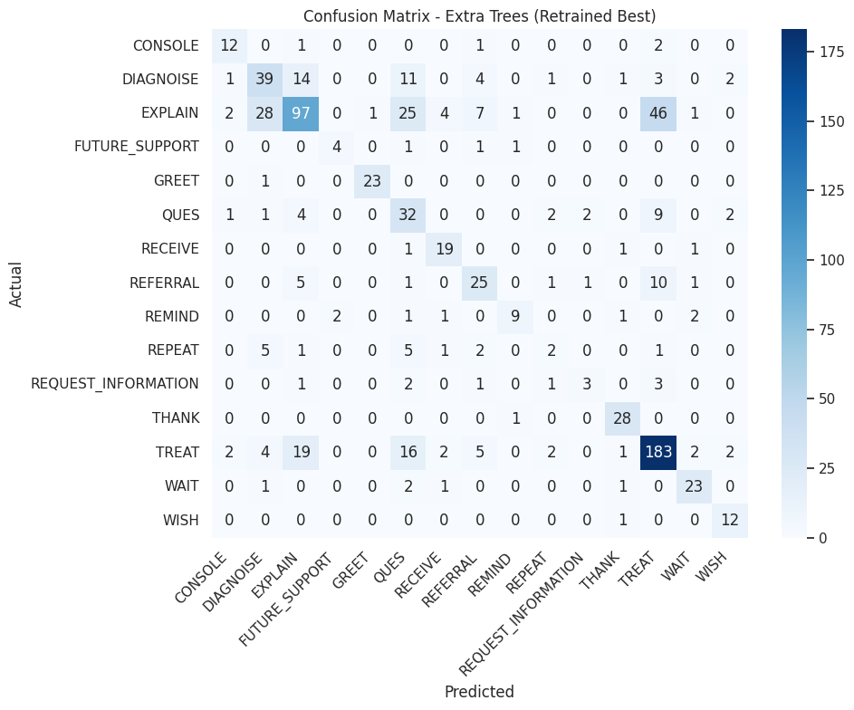
Model Performance Overview:
This confusion matrix presents the validation performance of the Extra Trees (Retrained Best) model.
Like Random Forest, Extra Trees delivered strong predictions for major categories like TREAT, EXPLAIN, and THANK, maintaining a dominant diagonal structure.
Some confusion persisted among closely related classes, especially between EXPLAIN, DIAGNOSE, and TREAT, though performance remained relatively stable across rare classes.
Overall, Extra Trees achieved high accuracy and maintained good class balance, offering robust performance on both frequent and minority labels.

Slide 24
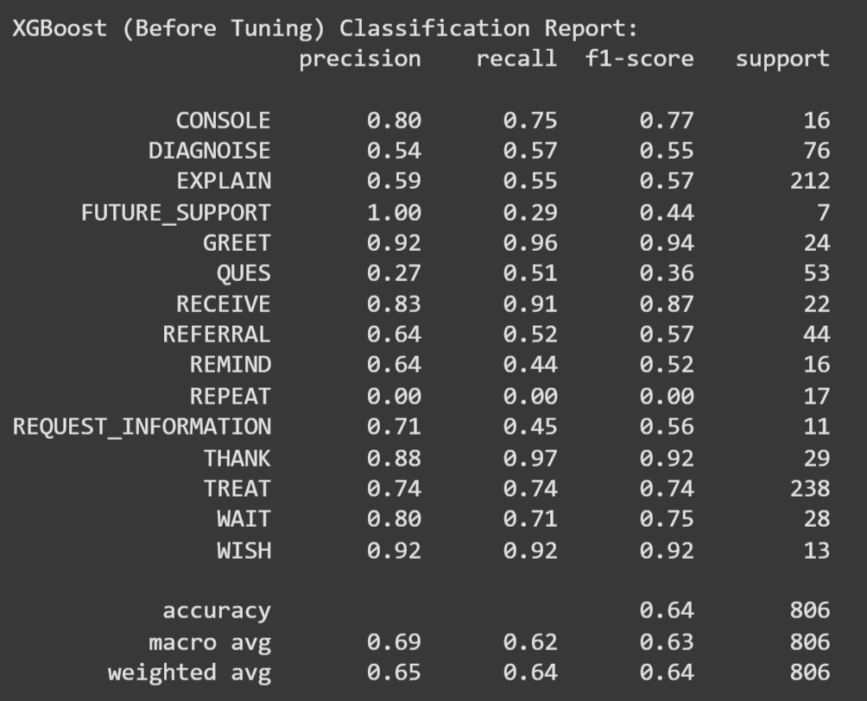
XGBoost Classifier
0.64
Validation F1
Balanced measure of precision and recall
64%
Accuracy
Overall correct classifications
The XGBoost model achieved 64% accuracy and a Validation F1-score of 0.64, capturing major classes effectively but still showing boundary confusion among closely related categories, indicating strong potential for improvement with hyperparameter tuning.

Slide 25
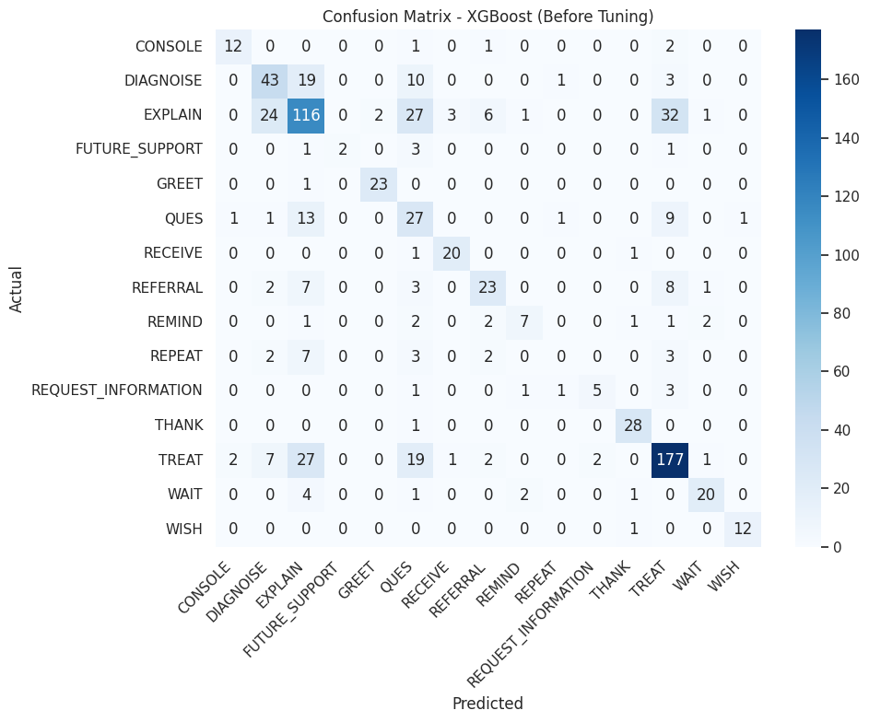
Model Performance Overview:
This confusion matrix represents the validation performance of the XGBoost (Before Tuning) model.
XGBoost captured major classes like TREAT, EXPLAIN, and THANK relatively well, with a strong concentration of predictions along the diagonal.
However, notable confusion was present between EXPLAIN, DIAGNOSE, and TREAT, especially before hyperparameter tuning, suggesting room for improvement in boundary separation.
Overall, XGBoost showed promise even before optimization, with solid performance on dominant classes and moderate confusion on harder-to-separate intents.

Slide 26
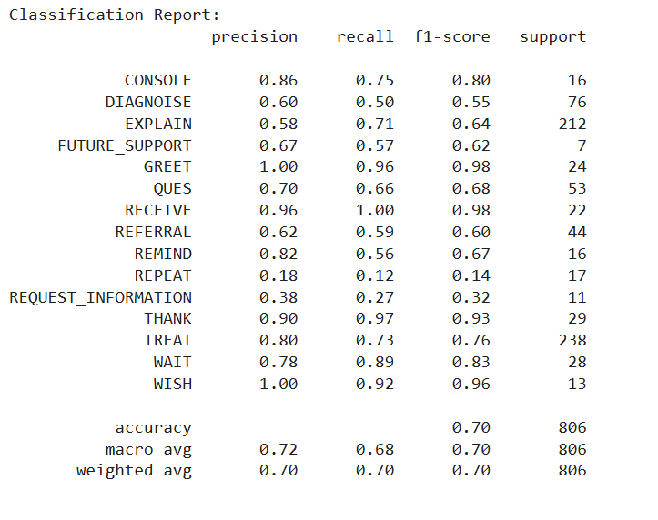
CNN Model (Deep Learning)
0.70
Validation F1
Balanced measure of precision and recall
70%
Accuracy
Overall correct classifications
The CNN model achieved 70% accuracy and a Validation F1-score of 0.70, capturing dominant classes well but still facing challenges in differentiating closely related medical categories, highlighting opportunities for further improvements with more context-aware models.

Slide 27
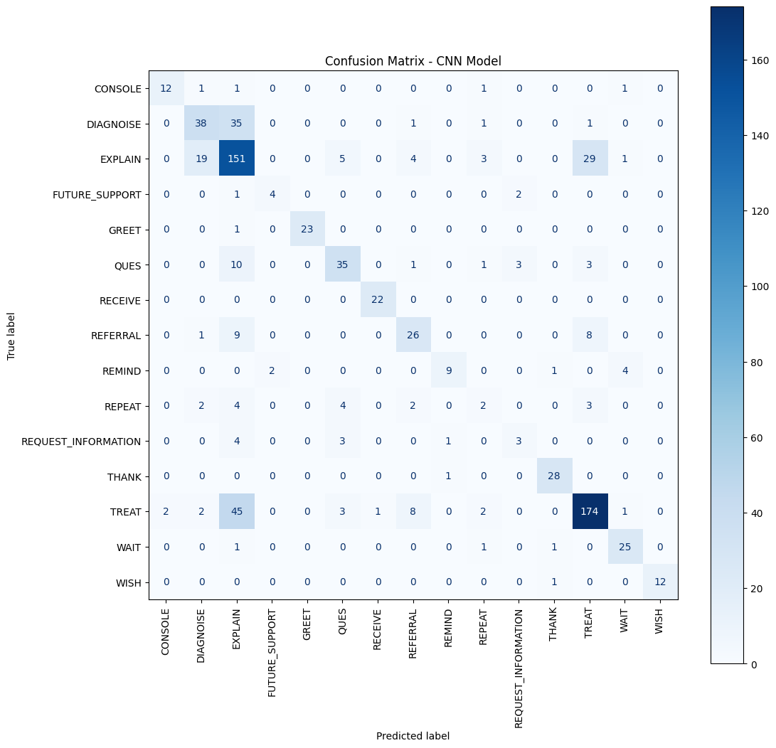
Model Performance Overview:
This confusion matrix shows the test set performance of the CNN Model.
The model captured dominant classes like TREAT, EXPLAIN, and THANK fairly well, evident from the strong diagonal.
However, noticeable confusion appeared between semantically similar classes such as DIAGNOSE, EXPLAIN, and TREAT, especially for longer or more complex sentences.
Overall, the CNN provided a lightweight, faster alternative to transformer models but struggled with nuanced distinctions compared to ClinicalBERT or DistilBERT.

Slide 28

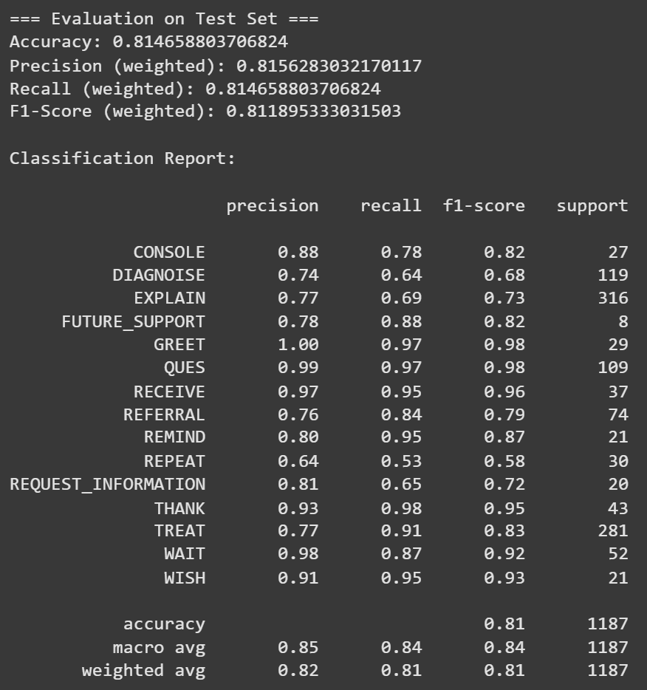
ClinicalBERT Model
Technique
Performance
Fine-tuning emilyalsentzer/Bio_ClinicalBERT for domain-specific classification.
Validation accuracy slightly lower than DistilBERT despite medical specialization.
Domain Advantage
Pre-trained on medical literature and clinical notes.
The specialized medical model underperformed compared to general models, likely due to limited dataset size.

Slide 29
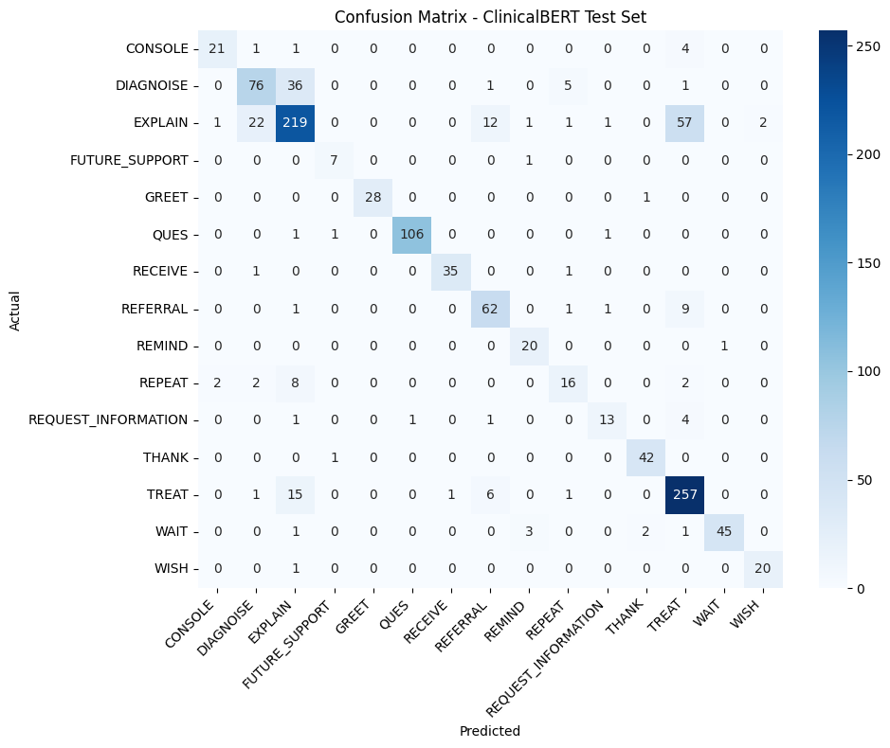
Model Performance Overview:
This confusion matrix summarizes the test set performance of the ClinicalBERT model.
ClinicalBERT achieved outstanding classification results with strong clustering along the diagonal for key categories like TREAT, EXPLAIN, QUES, and THANK.
Only limited confusion is observed, mainly between semantically close classes such as DIAGNOSE and EXPLAIN, but overall, ClinicalBERT maintained high accuracy and recall across both frequent and rare categories.
The model demonstrated superior understanding of domain-specific conversational patterns, validating the benefit of fine-tuning on a specialized clinical language model.

Slide 30
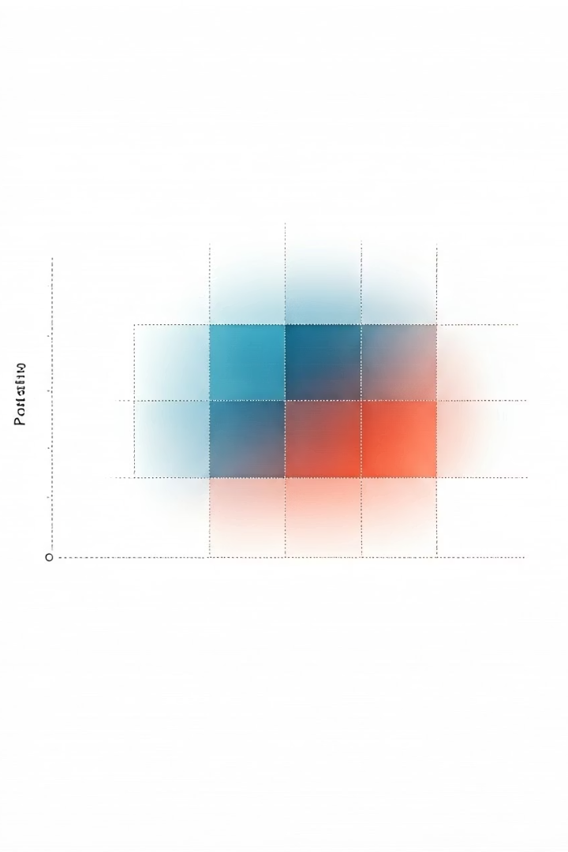
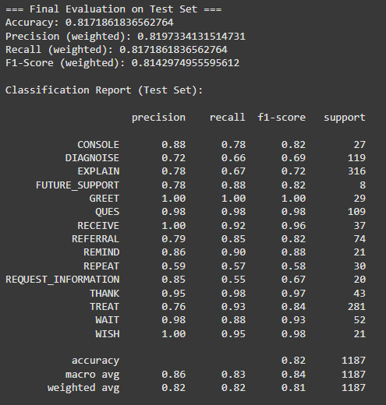
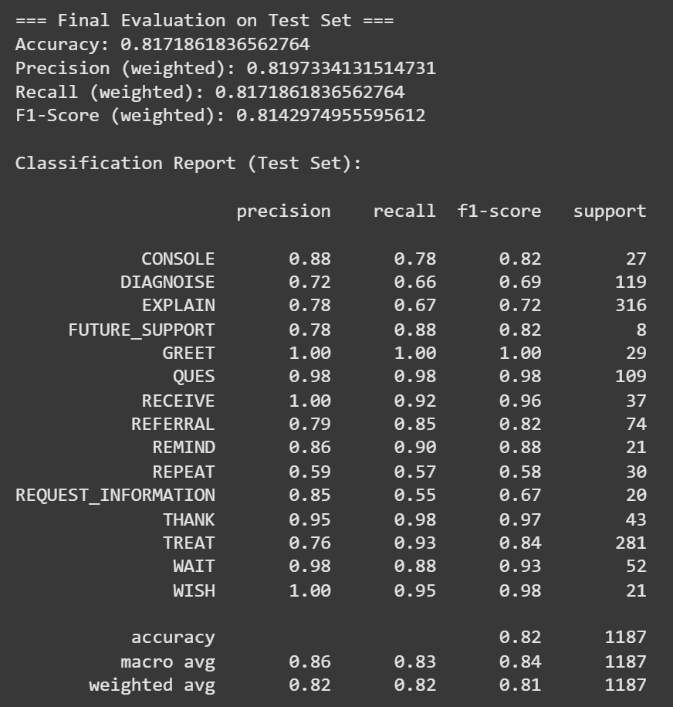
DistilBERT Model - Our Best Model
81.5%
Validation Accuracy
Highest among all tested models
81.1%
Validation F1-Score
Balanced precision and recall
81.7%
Test Accuracy
Consistent performance on unseen data
81.4%
Test F1-Score
Strong generalization capability
DistilBERT achieves superior performance while maintaining computational efficiency. The model excels across all metrics.

Slide 31
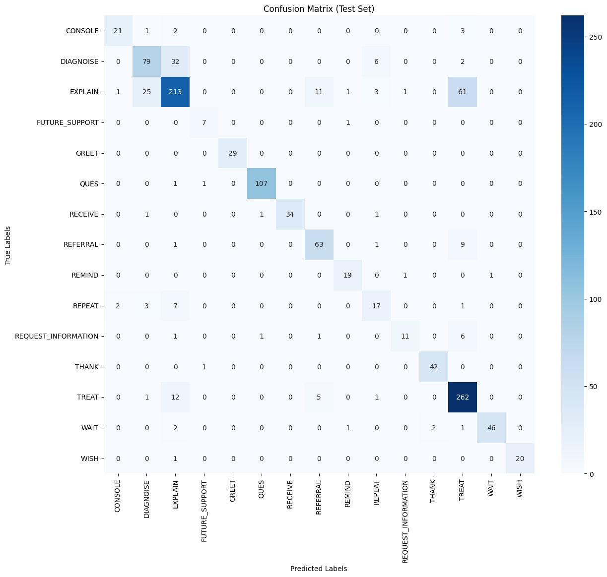
Model Performance Overview:
This confusion matrix shows the test set performance of the DistilBERT model.
DistilBERT achieved strong and consistent classification, with a clear and sharp diagonal for major classes like TREAT, EXPLAIN, QUES, and THANK.
Very limited confusion is observed across the matrix, demonstrating the model's excellent generalization ability.
Minor errors occurred mainly between semantically similar categories such as DIAGNOSE and EXPLAIN, but overall, DistilBERT showed high precision, recall, and stability across both frequent and minority classes.

Slide 32

What We Overcame at Each Step
Attempt
Challenge
What We Learned
Logistic Regression, SVM,RidgeClassifier
Can't capture semantic meaning
Need more context- aware features
CNN
Captures local patterns, misses full sentence
Transformers needed
ClinicalBERT
Overfit risk, computationally heavy
Dataset size matters
DistilBERT
Balanced lightweight model
Pretrained generalization works

Slide 33








Thinking Behind Each Model Choice
DistilBERT Selection
Optimal balance of performance and efficiency
BERT Variants
Leveraging contextual embeddings
Convolutional Networks
Capturing local n-gram relationships
Traditional Models
Establishing performance baselines
DistilBERT leverages Wikipedia and BookCorpus pretraining. It provides excellent speed-performance balance with reduced computational requirements.

Slide 34








Why BERT Outperformed Everything Else
Minimal Preprocessing
Context-Aware
No manual feature engineering required
Bidirectional attention captures word relationships
Task Adaptation
Strong Architecture
Fine-tuning for medical classification specifics
Multi-head attention for complex patterns
Transformer models redefine text classification by automating feature engineering. They eliminate dependence on manual feature crafting.

Slide 35
Thank You! Questions?

